Slide 1
Clustering with Gaussian Mixtures
Andrew W. Moore Professor
School of Computer Science Carnegie Mellon University
www.cs.cmu.edu/~awm awm@cs.cmu.edu
412-268-7599
Copyright © 2001, 2004, Andrew W. Moore
Note to other teachers and users of these slides. Andrew would be delighted if you found this source material useful in giving your own lectures. Feel free to use these slides verbatim, or to modify them to fit your own needs. PowerPoint originals are available. If you make use of a significant portion of these slides in your own lecture, please include this message, or the following link to the source repository of Andrew’s tutorials: http://www.cs.cmu.edu/~awm/tutorials . Comments and corrections gratefully received.
Unsupervised Learning
You walk into a bar.
A stranger approaches and tells you:
“I’ve got data from k classes. Each class produces observations with a normal distribution and variance σ²I . Standard simple multivariate gaussian assumptions. I can tell you all the P(w_{i})’s .”
So far, looks straightforward.
“I need a maximum likelihood estimate of the µ_{i}’s .“
No problem:
“There’s just one thing. None of the data are labeled. I have datapoints, but I don’t know what class they’re from (any of them!)
Uh oh!!
Copyright © 2001, 2004, Andrew W. Moore
Clustering with Gaussian Mixtures: Slide 2

Slide 2
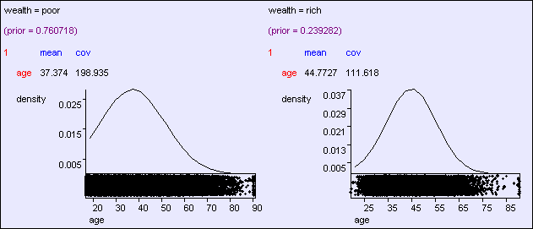
Gaussian Bayes Classifier Reminder
_{P( y = i | x) =} p(x | y = i)P( y = i)
p(x)
1
exp⎡− ¹ (x − µ ) Σ (x − µ )⎤ p
(2π ) || Σ ||
⎢⎣
k
i
T
i k i ⎥⎦ i
P( y = i | x) =
m / 2 1/ 2
2
i
p(x)
How do we deal with that?
Copyright © 2001, 2004, Andrew W. Moore
Clustering with Gaussian Mixtures: Slide 3
Predicting wealth from age
Copyright © 2001, 2004, Andrew W. Moore
Clustering with Gaussian Mixtures: Slide 4

Slide 3
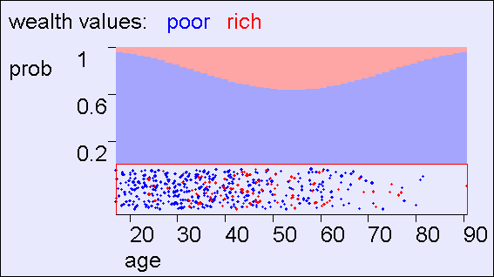
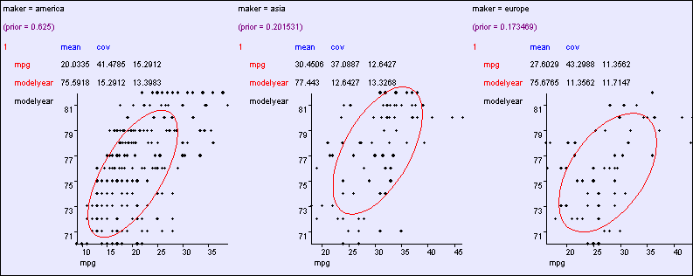
Predicting wealth from age
Copyright © 2001, 2004, Andrew W. Moore
Clustering with Gaussian Mixtures: Slide 5
Learning modelyear , mpg ---> maker
⎜
Σ = ⎜
⎛σ ²1 σ
L σ ⎞
12
1m ⎟
⎜ σ σ ² 2 L σ ⎟
M M O M
⎜
12
2 m
⎟
⎜_{σ}
⎟
⎝ 1m
σ L σ
2
⎟
2 m
m
⎠
Copyright © 2001, 2004, Andrew W. Moore
Clustering with Gaussian Mixtures: Slide 6

Slide 4
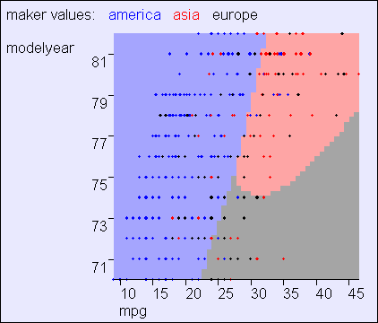
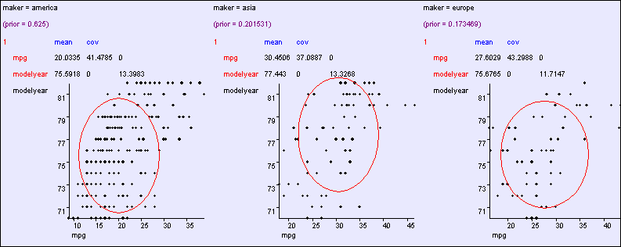
General: O(m²)
parameters
L σ _{1m} ⎞
⎟
⎜ σ σ ² 2 L σ ⎟
⎜
Σ = ⎜
⎛σ ²1 σ
12
12
2 m
⎟
⎜
M
M O M
⎟
⎜_{σ}
σ L σ
2
⎟
⎝ 1m
2 m
m
⎠
Copyright © 2001, 2004, Andrew W. Moore
Clustering with Gaussian Mixtures: Slide 7
⎛σ ²1
Aligned: O(m)
parameters
⎜ 0 0 L 0 0 ⎞
⎟
⎜ 0 σ ²2 0 L 0 0 ⎟
⎜ 0 0 σ ²3 L 0
⎜ M M M O M M ⎟
⎜ 0 0 L σ ² m −1
0 0 L 0
₀ ⎟
Σ = ⎜
⎟
⎜ ₀
₀ ⎟
⎟
⎜ ₀
2 ⎟
σ m
⎝ ⎠
Copyright © 2001, 2004, Andrew W. Moore Clustering with Gaussian Mixtures: Slide 8

Slide 5
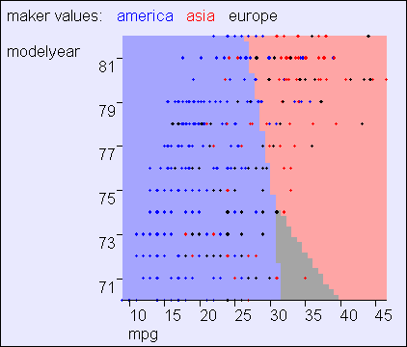
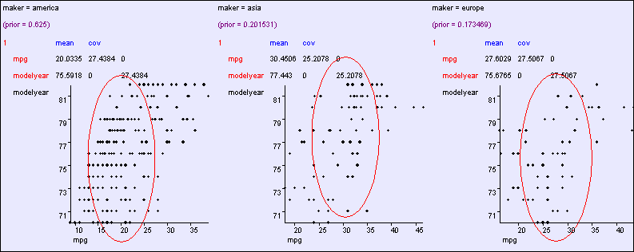
Aligned: O(m)
parameters
⎛σ ²1
⎜ 0 0 L 0 0 ⎞
⎟
⎜ 0 σ ²2 0 L 0 0 ⎟
⎜ 0 0 σ ²3 L 0
⎜ M M M O M M ⎟
⎜ 0 0 L σ ² m −1
0 0 L 0
₀ ⎟
Σ = ⎜
⎟
⎜ ₀
₀ ⎟
⎟
⎜ ₀
2 ⎟
σ m
⎝ ⎠
Copyright © 2001, 2004, Andrew W. Moore Clustering with Gaussian Mixtures: Slide 9
Spherical: O(1)
cov parameters
⎛σ ² 0 0 L 0 0 ⎞
⎜ ⎟
⎜ 0 σ ² 0 L 0 0 ⎟
⎜ 0 0 σ ² L 0
⎜ M M M O M M ⎟
0 0 L σ ²
0 0 L 0 σ
₀ ⎟
Σ = ⎜
⎟
⎜ ₀
₀ ⎟
⎜
⎟
⎜ ₀
2 ⎟
⎝ ⎠
Copyright © 2001, 2004, Andrew W. Moore Clustering with Gaussian Mixtures: Slide 10

Slide 6
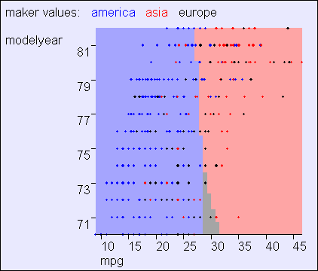
Spherical: O(1)
cov parameters
⎛σ ² 0 0 L 0 0 ⎞
⎜ ⎟
⎜ 0 σ ² 0 L 0 0 ⎟
⎜ 0 0 σ ² L 0
⎜ M M M O M M ⎟
0 0 L σ ²
0 0 L 0 σ
₀ ⎟
Σ = ⎜
⎟
⎜ ₀
₀ ⎟
⎜
⎟
⎜ ₀
2 ⎟
⎝ ⎠
Copyright © 2001, 2004, Andrew W. Moore Clustering with Gaussian Mixtures: Slide 11
Making a Classifier from a Density Estimator
Categorical inputs only
Real-valued inputs only
Mixed Real / Cat okay
Inputs Inputs Inputs
Classifier
Predict category
Joint BC
Naïve BC
Gauss BC
Dec Tree
Density Estimator
Prob- ability
Joint DE Naïve DE
Gauss DE
Regressor
Predict real no.
Copyright © 2001, 2004, Andrew W. Moore
Clustering with Gaussian Mixtures: Slide 12

Slide 7
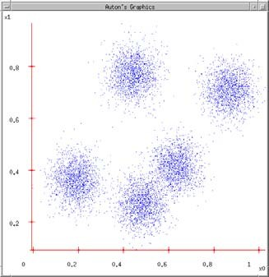
Next… back to Density Estimation
What if we want to do density estimation with multimodal or clumpy data?
Copyright © 2001, 2004, Andrew W. Moore
Clustering with Gaussian Mixtures: Slide 13
The GMM assumption
There are k components. The i’th component is called ω_{i}
Component ω_{i} has an
associated mean vector μ_{i} μ₂
μ₁
μ₃
Copyright © 2001, 2004, Andrew W. Moore
Clustering with Gaussian Mixtures: Slide 14

Slide 8
The GMM assumption
There are k components. The i’th component is called ω_{i}
Component ω_{i} has an
associated mean vector μ_{i}
Each component generates data from a Gaussian with mean μ_{i} and covariance matrix σ²I
μ₂
μ₁
Assume that each datapoint is generated according to the following recipe:
μ₃
Copyright © 2001, 2004, Andrew W. Moore
Clustering with Gaussian Mixtures: Slide 15
The GMM assumption
There are k components. The i’th component is called ω_{i}
Component ω_{i} has an
associated mean vector μ_{i}
Each component generates data from a Gaussian with mean μ_{i} and covariance matrix σ²I
μ₂
Assume that each datapoint is generated according to the following recipe:
1. Pick a component at random. Choose component i with probability P(ω_{i}).
Copyright © 2001, 2004, Andrew W. Moore
Clustering with Gaussian Mixtures: Slide 16

Slide 9
The GMM assumption
There are k components. The i’th component is called ω_{i}
Component ω_{i} has an
associated mean vector μ_{i}
Each component generates data from a Gaussian with mean μ_{i} and covariance matrix σ²I
μ₂
x
Assume that each datapoint is generated according to the following recipe:
Pick a component at random. Choose component i with probability P(ω_{i}).
Datapoint ~ N(μ_{i}, σ²I )
Copyright © 2001, 2004, Andrew W. Moore Clustering with Gaussian Mixtures: Slide 17
The General GMM assumption
There are k components. The i’th component is called ω_{i}
Component ω_{i} has an
associated mean vector μ_{i}
Each component generates data from a Gaussian with mean μ_{i} and covariance matrix Σ_{i}
μ₂
μ₁
Assume that each datapoint is generated according to the following recipe:
μ₃
Pick a component at random. Choose component i with probability P(ω_{i}).
Datapoint ~ N(μ_{i}, Σ_{i} )
Copyright © 2001, 2004, Andrew W. Moore Clustering with Gaussian Mixtures: Slide 18

Slide 10
Unsupervised Learning: not as hard as it looks
Sometimes easy
IN CASE YOU’RE WONDERING WHAT THESE DIAGRAMS ARE, THEY SHOW 2-d UNLABELED DATA (X VECTORS) DISTRIBUTED IN 2-d SPACE. THE TOP ONE HAS THREE VERY CLEAR GAUSSIAN CENTERS
Sometimes impossible
and sometimes in between
Copyright © 2001, 2004, Andrew W. Moore
Clustering with Gaussian Mixtures: Slide 19
Computing likelihoods in unsupervised case
We have x₁ , x_{2 , …} x_{N}
We know P(w₁) P(w₂) .. P(w_{k})
We know σ
P(x|w_{i}, µ_{i}, … µ_{k}) = Prob that an observation from class
w_{i} would have value x given class means µ₁… µ_{x}
Can we write an expression for that?
Copyright © 2001, 2004, Andrew W. Moore
Clustering with Gaussian Mixtures: Slide 20

Slide 11
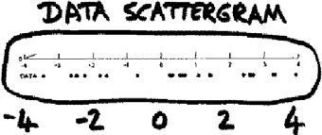
likelihoods in unsupervised case
We have x₁ x₂ … x_{n}
We have P(w₁) .. P(w_{k}). We have σ.
We can define, for any x , P(x|w_{i} , µ₁, µ₂ .. µ_{k})
Can we define P(x | µ₁, µ₂ .. µ_{k})?
Can we define P(x₁, x₁, .. x_{n} | µ₁, µ₂ .. µ_{k})?
[YES, IF WE ASSUME THE X₁’S WERE DRAWN INDEPENDENTLY]
Copyright © 2001, 2004, Andrew W. Moore Clustering with Gaussian Mixtures: Slide 21
Unsupervised Learning: Mediumly Good News
We now have a procedure s.t. if you give me a guess at µ₁, µ₂ .. µ_{k,}
I can tell you the prob of the unlabeled data given those µ‘s.
Suppose x‘s are 1-dimensional. There are two classes; w₁ and w₂
(From Duda and Hart)
P(w₁) = 1/3 P(w₂) = 2/3 σ = 1 .
There are 25 unlabeled datapoints
x₁ = 0.608
x₂ = -1.590
x₃ = 0.235
x₄ = 3.949
:
x₂₅ = -0.712
Copyright © 2001, 2004, Andrew W. Moore
Clustering with Gaussian Mixtures: Slide 22

Slide 12
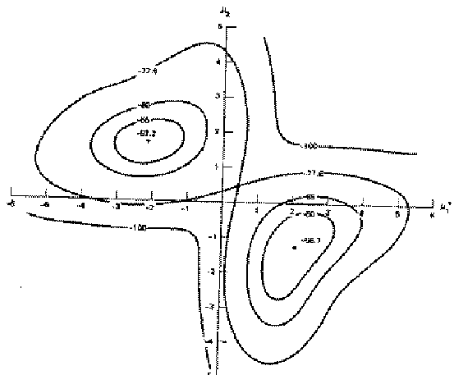
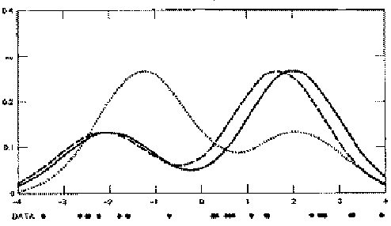
Duda & Hart’s Example
Graph of
log P(x₁, x₂ .. x₂₅ | µ₁, µ₂ ) against µ₁ (→) and µ₂ (↑)
Max likelihood = (µ₁ =-2.13, µ₂ =1.668)
Local minimum, but very close to global at (µ₁ =2.085, µ₂ =-1.257)*
* corresponds to switching w₁ + w₂.
Copyright © 2001, 2004, Andrew W. Moore
Clustering with Gaussian Mixtures: Slide 23
Duda & Hart’s Example
We can graph the prob. dist. function of data given our
µ₁ and µ₂
estimates.
We can also graph the true function from which the data was randomly generated.
They are close. Good.
The 2nd solution tries to put the “2/3” hump where the “1/3” hump should go, and vice versa.
In this example unsupervised is almost as good as supervised. If the x₁ .. x₂₅ are given the class which was used to learn them, then the results are (µ₁=-2.176, µ₂=1.684). Unsupervised got (µ₁=-2.13, µ₂=1.668).
Copyright © 2001, 2004, Andrew W. Moore Clustering with Gaussian Mixtures: Slide 24

Slide 13
Finding the max likelihood µ₁,µ₂..µ_{k}
We can compute P( data | µ₁,µ₂..µ_{k})
How do we find the µ_{i}‘s which give max. likelihood?
The normal max likelihood trick: Set  log Prob (….) = 0
 µ_{i}
and solve for µ_{i}‘s.
# Here you get non-linear non-analytically- solvable equations
Use gradient descent Slow but doable
Use a much faster, cuter, and recently very popular method…
Copyright © 2001, 2004, Andrew W. Moore
Clustering with Gaussian Mixtures: Slide 25
Expectation Maximalization
Copyright © 2001, 2004, Andrew W. Moore
Clustering with Gaussian Mixtures: Slide 26

Slide 14
The E.M. Algorithm
DETOUR
We’ll get back to unsupervised learning soon.
But now we’ll look at an even simpler case with hidden information.
The EM algorithm
Can do trivial things, such as the contents of the next few slides.
An excellent way of doing our unsupervised learning problem, as we’ll see.
Many, many other uses, including inference of Hidden Markov Models (future lecture).
Copyright © 2001, 2004, Andrew W. Moore
Clustering with Gaussian Mixtures: Slide 27
Silly Example
Let events be “grades in a class” w₁ = Gets an A
w₂ = Gets a B
P(A) = ½
P(B) = µ P(C) = 2µ P(D) = ½-3µ
(Note 0 ≤ µ ≤1/6)
w₃ = Gets a C w₄ = Gets a D
Assume we want to estimate µ from data. In a given class there were
A’s
B’s
C’s
D’s
What’s the maximum likelihood estimate of µ given a,b,c,d ?
Copyright © 2001, 2004, Andrew W. Moore Clustering with Gaussian Mixtures: Slide 28

Slide 15
Silly Example
Let events be “grades in a class”
w₁ = Gets an A P(A) = ½
w₂ = Gets a B P(B) = µ
w₃ = Gets a C P(C) = 2µ
w₄ = Gets a D P(D) = ½-3µ (Note 0 ≤ µ ≤1/6)
Assume we want to estimate µ from data. In a given class there were
A’s
B’s
C’s
D’s
What’s the maximum likelihood estimate of µ given a,b,c,d ?
Copyright © 2001, 2004, Andrew W. Moore
Clustering with Gaussian Mixtures: Slide 29
Trivial Statistics
P(A) = ½ P(B) = µ P(C) = 2µ P(D) = ½-3µ
P( a,b,c,d | µ) = K(½)ª(µ)^{b}(2µ)^{c}(½-3µ)^{d}
log P( a,b,c,d | µ) = log K + alog ½ + blog µ + clog 2µ + dlog (½-3µ)
FOR MAX LIKE µ, SET ^{∂LogP} = 0
∂LogP ₌ b ₊ 2c ₋ 3d
∂µ µ 2µ 1 / 2 − 3µ
∂µ
= 0
Gives max like µ =
b + c
6 (b + c + d )
So if class got
A | B | C | D
14 | 6 | 9 | 10
Max like µ = ¹
10
Copyright © 2001, 2004, Andrew W. Moore
Boring, but true!
Clustering with Gaussian Mixtures: Slide 30

Slide 16
Same Problem with Hidden Information
Someone tells us that
Number of High grades (A’s + B’s) = h
Number of C’s = c
Number of D’s = d
What is the max. like estimate of µ now?
REMEMBER
P(A) = ½
P(B) = µ P(C) = 2µ P(D) = ½-3µ
Copyright © 2001, 2004, Andrew W. Moore
Clustering with Gaussian Mixtures: Slide 31
Same Problem with Hidden Information
Someone tells us that
Number of High grades (A’s + B’s) = h
Number of C’s = c
Number of D’s = d
What is the max. like estimate of µ now? We can answer this question circularly:
If we know the value of µ we could compute the expected value of a and b 1
REMEMBER
P(A) = ½
P(B) = µ P(C) = 2µ P(D) = ½-3µ
EXPECTATION
2
µ
¹ + µ
2
Since the ratio a:b should be the same as the ratio ½ : μ
a = h b =
h
MAXIMIZATION
¹ + µ
2
If we know the expected values of a and b we could compute the maximum likelihood value of µ
Copyright © 2001, 2004, Andrew W. Moore
µ =
b + c
6(b + c + d )
Clustering with Gaussian Mixtures: Slide 32

Slide 17
E.M. for our Trivial Problem
REMEMBER
P(A) = ½
P(B) = µ P(C) = 2µ P(D) = ½-3µ
We begin with a guess for µ
We iterate between EXPECTATION and MAXIMALIZATION to improve our estimates of µ and a and b.
Define µ(t) the estimate of µ on the t’th iteration b(t) the estimate of b on t’th iteration
µ(0) = initial guess
b(t) =
1
µ(t)h
= Ε[b | µ(t)]
E-step
2
+ µ(t)
µ(t +1) = ^{b(t )+ c}
M-step
6(b(t )+ c + d )
= max like est of µ given b(t )
Continue iterating until converged.
Good news: Converging to local optimum is assured. Bad news: I said “local” optimum.
Copyright © 2001, 2004, Andrew W. Moore
Clustering with Gaussian Mixtures: Slide 33
E.M. Convergence
Convergence proof based on fact that Prob(data | µ) must increase or remain same between each iteration [NOT OBVIOUS]
But it can never exceed 1 [OBVIOUS]
So it must therefore converge [OBVIOUS]
t
0 0
1 0.0833
2 0.0937
3 0.0947
4 0.0948
5 0.0948
6 0.0948
In our example, suppose we had
h = 20
c = 10
d = 10
µ(0) = 0
Convergence is generally linear: error decreases by a constant factor each time step.
Copyright © 2001, 2004, Andrew W. Moore
µ(t)
0
2.857
3.158
3.185
3.187
3.187
3.187
b(t)
Clustering with Gaussian Mixtures: Slide 34

Slide 18
Back to Unsupervised Learning of GMMs
Remember:
We have unlabeled data x₁ x₂ … x_{R}
We know there are k classes
We know P(w₁) P(w₂) P(w₃) … P(w_{k}) We don’t know µ₁ µ₂ .. µ_{k}
We can write P( data | µ₁…. µ_{k})
= p(x ...x µ ...µ )
1 R 1 k
= ∏p(x_{i} µ₁...µ_{k} ) i=1
R
R k
p(x_{i} w_{j} ,µ₁...µ_{k} )P(w_{j} )
⁼ ∏∑
i=1 j =1
1
R k
x − µ ) P(
w )
= ∏∑K exp⎛− (
2 ⎞
⎜
i j
⎟
j
i=1 j =1
⎝ 2σ²
⎠
Copyright © 2001, 2004, Andrew W. Moore
Clustering with Gaussian Mixtures: Slide 35
E.M. for GMMs
For Max likelihood we know ∂ log Pr ob(data µ ...µ )= 0
∂µ
i
1 k
Some wild' n' crazy algebra turns this into :" For Max likelihood, for each j,
R
P(w x , µ ...µ ) x
j i 1 k i
∑
i=1
µ =
See
http://www.cs.cmu.edu/~awm/doc/gmm-algebra.pdf
j R
P(w x ,µ ...µ )
∑ j i 1 k
i=1
This is n nonlinear equations in µ_{j}’s.”
If, for each x_{i} we knew that for each w_{j} the prob that µ_{j} was in class w_{j} is P(w_{j}|x_{i},µ₁…µ_{k}) Then… we would easily compute µ_{j}.
If we knew each µ_{j} then we could easily compute P(w_{j}|x_{i},µ₁…µ_{k}) for each w_{j} and x_{i}.
…I feel an EM experience coming on!!
Copyright © 2001, 2004, Andrew W. Moore
Clustering with Gaussian Mixtures: Slide 36

Slide 19
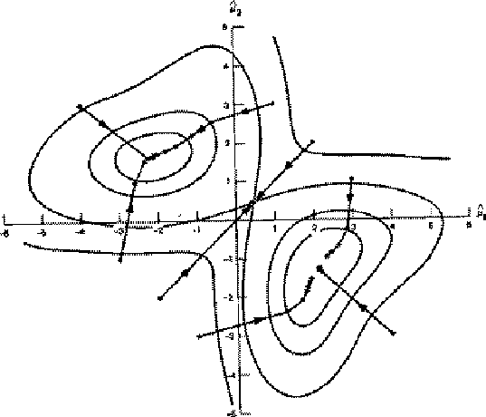
E.M. for GMMs
Iterate. On the t’th iteration let our estimates be
λ_{t} = { µ₁(t), µ₂(t) … µ_{c}(t) }
E-step
Compute “expected” classes of all datapoints for each class
Just evaluate a Gaussian at x_{k}
( λ ) ( λ )
p(x w , μ (t),σ I)p (t)
P(w x , λ )=
p x w , _{t} P w_{i}
2
k i t
=
k i i i
i k t
p(x λ )
c
∑
( μ _{j} (t),σ I)p _{j} (t)
M-step.
k t
p x_{k} w_{j} ,
2
j =1
Compute Max. like µ given our data’s class membership distributions
µ_{i} (t +1) = ^{k}
∑P(w_{i} x_{k} , λ_{t} ) x_{k}
P(w x , λ )
∑ i k t
k
Copyright © 2001, 2004, Andrew W. Moore
Clustering with Gaussian Mixtures: Slide 37
E.M.
Convergence
Your lecturer will (unless out of time) give you a nice intuitive explanation of why this rule works.
As with all EM procedures,
convergence to a local optimum guaranteed.
Copyright © 2001, 2004, Andrew W. Moore
This algorithm is REALLY USED. And in high dimensional state spaces, too.
E.G. Vector Quantization for Speech Data
Clustering with Gaussian Mixtures: Slide 38

Slide 20
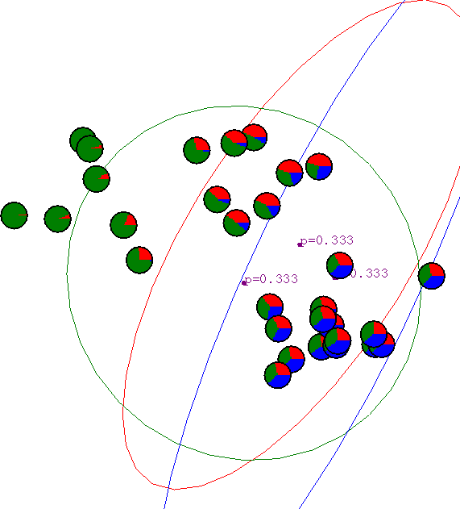
E.M. for General GMMs
p_{i}(t) is shorthand for estimate of P(ω_{i}) on t’th
Iterate. On the t’th iteration let our estimates be
iteration
λ_{t} = { µ₁(t), µ₂(t) … µ_{c}(t), Σ₁(t), Σ₂(t) … Σ_{c}(t), p₁(t), p₂(t) … p_{c}(t) }
E-step
Compute “expected” classes of all datapoints for each class
Just evaluate a Gaussian at x_{k}
P(w x , λ )=
p(x w , λ )P(w λ ) p(x w , μ (t), Σ (t))p (t)
k i t i t k i i i i
p(x λ )
i k t
=
c
∑
( μ _{j} (t), Σ _{j} (t))p _{j} (t)
M-step.
k t
j =1
p x_{k} w_{j} ,
Compute Max. like µ given our data’s class membership distributions
∑P(w x , λ ) x
P(w x , λ )[
x − μ (t +1)][x − μ (t +1)]
µ_{i} (t +1) = ^{k}
i k t k
Σ_{i} (t +1) =
∑ i k t k i k i k
T
P(w x , λ )
∑ ( λ )
∑ i
k t
k
P w_{i} x_{k} , _{t}
k
∑P(w_{i} x_{k} , λ_{t} )
p_{i} (t +1) = ^{k}
R = #records
R
Copyright © 2001, 2004, Andrew W. Moore
Clustering with Gaussian Mixtures: Slide 39
Gaussian Mixture Example: Start
Advance apologies: in Black and White this example will be incomprehensible
Copyright © 2001, 2004, Andrew W. Moore
Clustering with Gaussian Mixtures: Slide 40

Slide 21
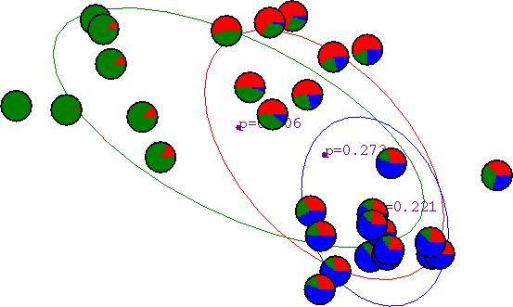

After first iteration
Copyright © 2001, 2004, Andrew W. Moore
Clustering with Gaussian Mixtures: Slide 41
After 2nd iteration
Copyright © 2001, 2004, Andrew W. Moore
Clustering with Gaussian Mixtures: Slide 42

Slide 22
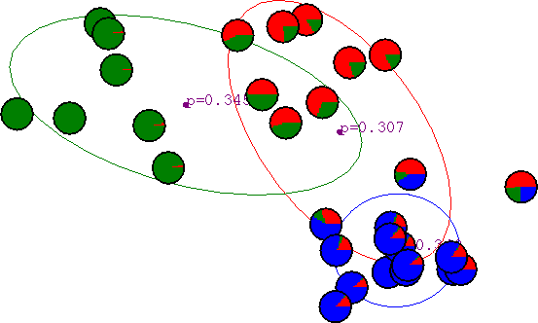
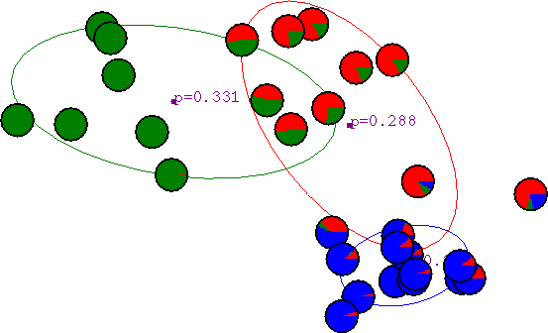
After 3rd iteration
Copyright © 2001, 2004, Andrew W. Moore
Clustering with Gaussian Mixtures: Slide 43
After 4th iteration
Copyright © 2001, 2004, Andrew W. Moore
Clustering with Gaussian Mixtures: Slide 44

Slide 23
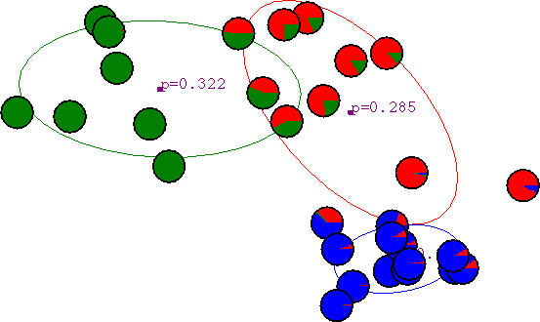

After 5th iteration
Copyright © 2001, 2004, Andrew W. Moore
Clustering with Gaussian Mixtures: Slide 45
After 6th iteration
Copyright © 2001, 2004, Andrew W. Moore
Clustering with Gaussian Mixtures: Slide 46

Slide 24
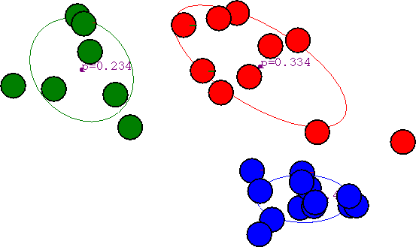
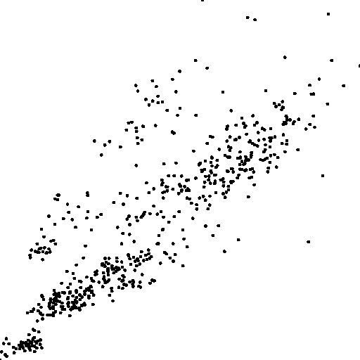
After 20th iteration
Copyright © 2001, 2004, Andrew W. Moore
Clustering with Gaussian Mixtures: Slide 47
Some Bio Assay data
Copyright © 2001, 2004, Andrew W. Moore
Clustering with Gaussian Mixtures: Slide 48

Slide 25
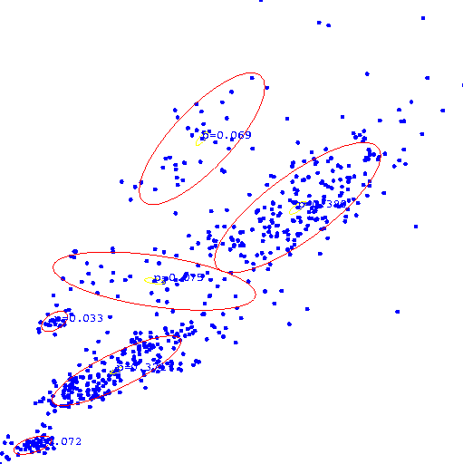

GMM
clustering of the assay data
Copyright © 2001, 2004, Andrew W. Moore
Clustering with Gaussian Mixtures: Slide 49
Resulting Density Estimator
Copyright © 2001, 2004, Andrew W. Moore
Clustering with Gaussian Mixtures: Slide 50

Slide 26
Where are we now?
Inputs Inputs Inputs Inputs
Inference Engine Learn
_{P(E1|E2)} Joint DE, Bayes Net Structure Learning
Classifier
Predict category
Prob- ability
Dec Tree, Sigmoid Perceptron, Sigmoid N.Net, Gauss/Joint BC, Gauss Naïve BC, N.Neigh, Bayes Net Based BC, Cascade Correlation
Joint DE, Naïve DE, Gauss/Joint DE, Gauss Naïve DE, Bayes Net Structure Learning, GMMs
Density Estimator
Regressor
Predict real no.
Linear Regression, Polynomial Regression, Perceptron, Neural Net, N.Neigh, Kernel, LWR, RBFs, Robust Regression, Cascade Correlation, Regression Trees, GMDH, Multilinear Interp, MARS
Copyright © 2001, 2004, Andrew W. Moore
Clustering with Gaussian Mixtures: Slide 51
The old trick…
Inputs Inputs Inputs Inputs
Inference Engine Learn
_{P(E1|E2)} Joint DE, Bayes Net Structure Learning
Classifier
Predict category
Prob- ability
Dec Tree, Sigmoid Perceptron, Sigmoid N.Net, Gauss/Joint BC, Gauss Naïve BC, N.Neigh, Bayes Net Based BC, Cascade Correlation, GMM-BC
Joint DE, Naïve DE, Gauss/Joint DE, Gauss Naïve DE, Bayes Net Structure Learning, GMMs
Density Estimator
Regressor
Predict real no.
Linear Regression, Polynomial Regression, Perceptron, Neural Net, N.Neigh, Kernel, LWR, RBFs, Robust Regression, Cascade Correlation, Regression Trees, GMDH, Multilinear Interp, MARS
Copyright © 2001, 2004, Andrew W. Moore
Clustering with Gaussian Mixtures: Slide 52

Slide 27
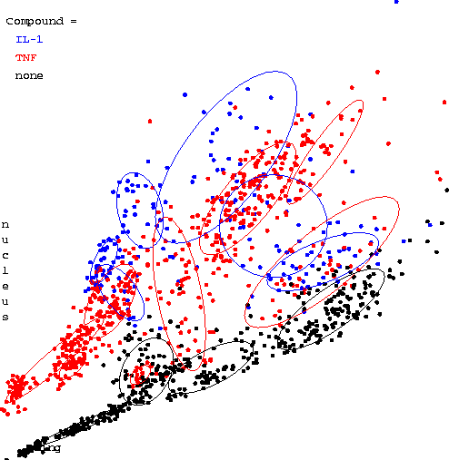
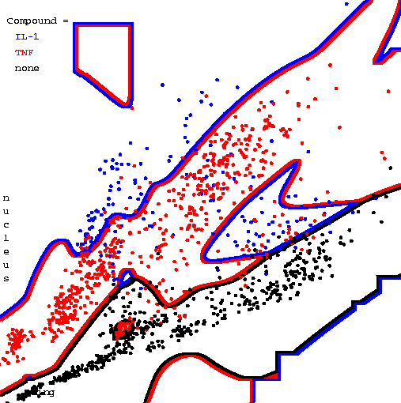
Three classes of assay
(each learned with it’s own mixture model)
(Sorry, this will again be semi-useless in black and white)
Copyright © 2001, 2004, Andrew W. Moore
Clustering with Gaussian Mixtures: Slide 53
Resulting Bayes Classifier
Copyright © 2001, 2004, Andrew W. Moore
Clustering with Gaussian Mixtures: Slide 54

Slide 28
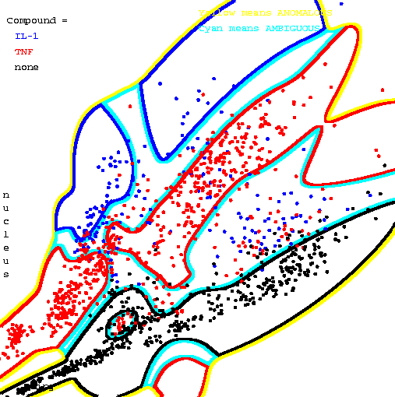
Resulting Bayes Classifier, using posterior probabilities to alert about ambiguity and anomalousness
Yellow means anomalous
Cyan means ambiguous
Copyright © 2001, 2004, Andrew W. Moore
Clustering with Gaussian Mixtures: Slide 55
Unsupervised learning with symbolic
attributes
missing
NATION
# KIDS
MARRIED
It’s just a “learning Bayes net with known structure but hidden values” problem.
Can use Gradient Descent.
EASY, fun exercise to do an EM formulation for this case too.
Copyright © 2001, 2004, Andrew W. Moore
Clustering with Gaussian Mixtures: Slide 56

Slide 29
Final Comments
Remember, E.M. can get stuck in local minima, and empirically it DOES.
Our unsupervised learning example assumed P(w_{i})’s known, and variances fixed and known. Easy to relax this.
It’s possible to do Bayesian unsupervised learning instead of max. likelihood.
There are other algorithms for unsupervised learning. We’ll visit K-means soon. Hierarchical clustering is also interesting.
Neural-net algorithms called “competitive learning” turn out to have interesting parallels with the EM method we saw.
Copyright © 2001, 2004, Andrew W. Moore Clustering with Gaussian Mixtures: Slide 57
What you should know
How to “learn” maximum likelihood parameters (locally max. like.) in the case of unlabeled data.
Be happy with this kind of probabilistic analysis.
Understand the two examples of E.M. given in these notes.
For more info, see Duda + Hart. It’s a great book. There’s much more in the book than in your handout.
Copyright © 2001, 2004, Andrew W. Moore
Clustering with Gaussian Mixtures: Slide 58

Slide 30
Other unsupervised learning methods
K-means (see next lecture)
Hierarchical clustering (e.g. Minimum spanning trees) (see next lecture)
Principal Component Analysis
simple, useful tool
Non-linear PCA
Neural Auto-Associators Locally weighted PCA
Others…
Copyright © 2001, 2004, Andrew W. Moore
Clustering with Gaussian Mixtures: Slide 59

